Slide 1
Factors That Drive Home Prices
Cameron Buzzard
Notes:
ID=d924773e-9a16-4d6d-9803-8cb819e99682 Recipe=text_billboard Type=TextOnly Variant=0 FamilyID=AccentBoxWalbaum_Zero

Slide 2
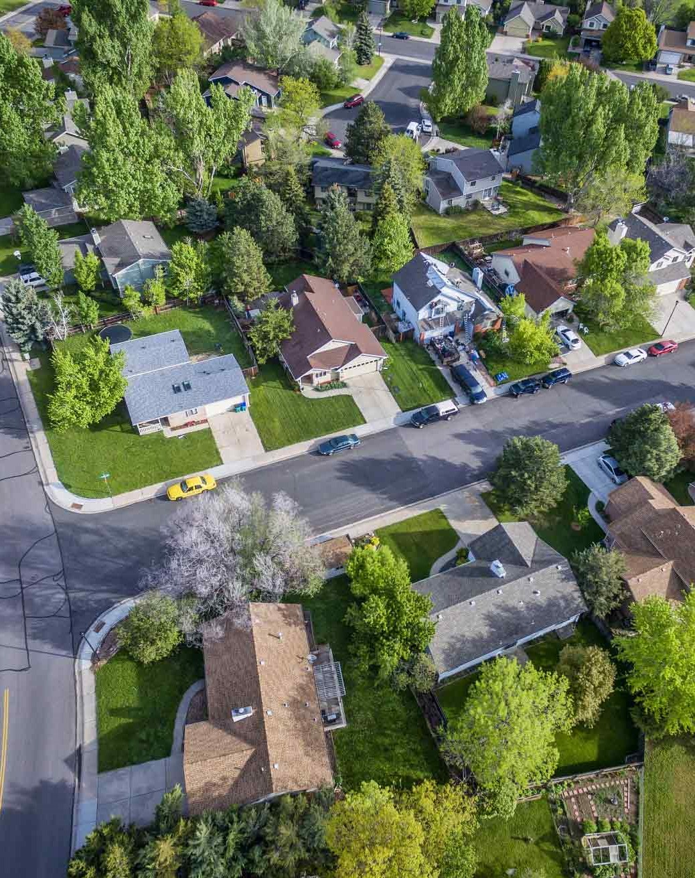
Agenda
Objective
Data Overview
Method
Findings
Recommendations

Slide 3
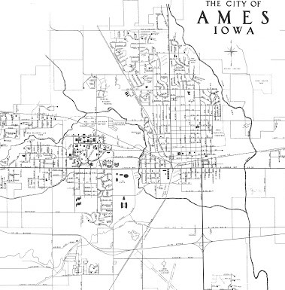
Objective
Determine what factors drive home prices based on the residential homes sold in Ames, Iowa from 2006 – 2010

Slide 4
Data Set
1460 residential homes sold
Ames, Iowa from 2006 – 2010
79 variables describing each home (categorical and continuous)
Avg sale price = $180,921
Original data: Kaggle

Slide 5
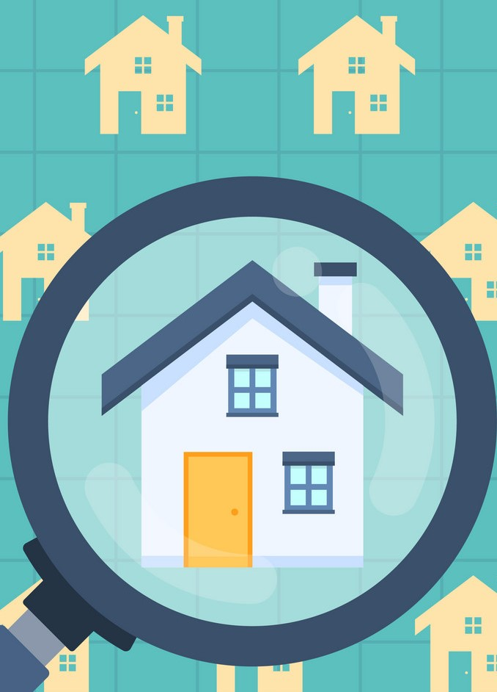
Method
Familiarize myself with the data
Created pivot tables and visualizations within Excel to start seeing patterns
Conducted t-tests on variables that stood out as having the greatest impact to home prices
Found 5 main factors

Slide 6
Findings
5 main factors that drive home prices

Slide 7
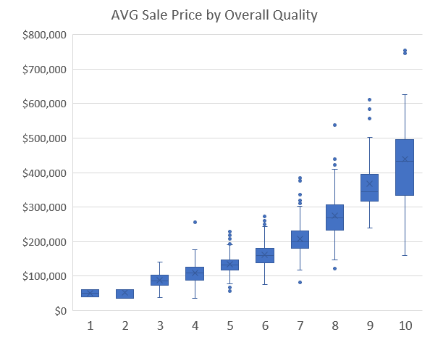
Overall Quality
Defined as overall material and finish quality
Target homes with quality rating of 8+ (229 sold)
8+ homes have an avg. price sold of $305,035
Hypothesis: There is no significant difference in home price based on Overall Quality (4 v 8)
Reject at 95% confidence, p-value < .0001

Slide 8
Ground Living Area
Above ground living area, square feet
Target homes with square feet greater than 1,678
708 homes sold (>1,678 ft²) with an average price of $227,539
Hypothesis: There is no significant difference in home price based on GrLivArea (<1450 vs >1678)
Reject at 95% confidence, p-value < .0001

Slide 9
Neighborhood
Target these top 10 neighborhoods by price:
NoRidge
NridgeHt
StoneBr
Timber
Veenker
Somerst
ClearCr
Crawfor
CollgCr
Blmngtn
Hypothesis: There is no significant difference in home price based on Neighborhood (tested Sawyer v NridgHt)
Reject at 95% confidence, p-value < .0001

Slide 10
Garage Cars
Size of the garage in car capacity
Target homes with at least a 3 car garage (186 sold)
3+ car garage has an avg. price sold of $306,491
Hypothesis: There is no significant difference in home price based on GarageCars (2 v 3)
Reject at 95% confidence, p-value < .0001

Slide 11
Central Air
Target homes with central air
Avg. price difference between homes with and without central air: $80,515
Hypothesis: There is no significant difference in home price based on having Central Air or not
Reject at 95% confidence, p-value < .0001

Slide 12
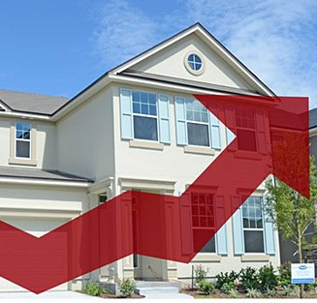
Recommendations
Prioritize these 5 factors when determining home prices:
Overall Quality (8+)
Ground Living Area (>1678)
Neighborhood (top 10)
Garage Cars (3+)
With Central Air
Homes that meet all 5 criteria:
Avg. price = $363,703

